Slide 1


Slide 2

Java OOP and Data Structures with Introduction to Secure Coding Dr. Ziping Liu
Chapter 2 Class: Just the Basics

Slide 3
https://he.kendallhunt.com/product/java-oop-and-data-structures-introduction-secure-coding
Chapter 2 Class: Just the Basics

Slide 4

Chapter Outlines
Defining a class
Differentiating between public and private
Drawing UML class diagrams for a single class
Writing a class constructor
Differentiating between objects and classes
Providing accessor and mutator methods
Preserving encapsulation
Maintaining proper accessibility
Utilizing this to refer to an object itself
Differentiating between clones, aliases, and originals
Tailoring additional instance methods
Overriding an object’s toString() method
Differentiating between referential and structural equality
Overriding an object’s equals() method
Case Study: Reverse Engineering Point2D

Slide 5
2.1 What is a class?
In Java, a class is such a user-defined data type
like a blueprint for a category of objects which all share common attributes (or data members) and behaviors (or member methods)
has two parts:
instance variables
instance methods

Slide 6
2.1 What is a class?
Syntax: defining a class
[public] class nameOfClass { [private] <type> instanceVariableName; [public] nameOfClass(optional parameters) { // initialize instance variables } [public] <returnType> instanceMethodName(parameters) { // do something } }
Core Concept: contents of a class
Instance variable(s): important characteristics of the class Constructor(s): initializes the class’s instance variables Instance method(s): actions using the class’s instance variables

Slide 7
2.1 What is a class?
Core Concept: accessibility
public: allows access to internal (within-class) and external (outside-of-class) users private: allows access ONLY to internal users
Core Concept: encapsulation
Do not let external users directly access instance variables. Keep these instance variables private.

Slide 8
2.1 What is a class?
Syntax: sketching a UML class diagram
nameOfClass
[+/-] instanceVariableName: type ... (more instance variables)
[+/-] instanceMethodName(<type> parameter1, ...): returnType ... (more instance methods)

Slide 9
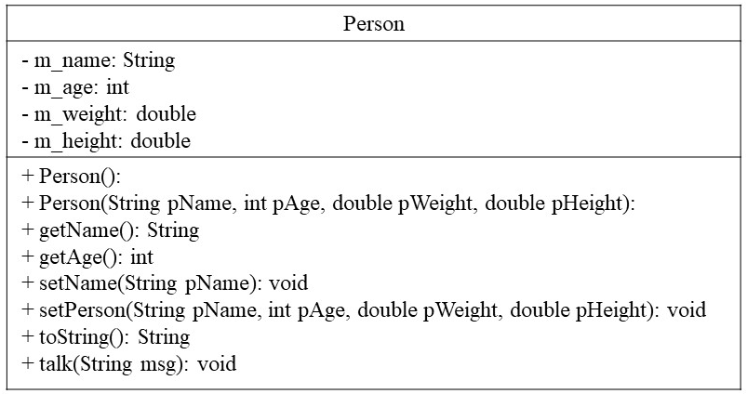
2.1 What is a class?
Figure 2 1 UML diagram for Person class

Slide 10
2.2 Constructors
A constructor “sets up” a class by initializing values of its instance variable
Constructors are also instance methods
must have the same name as the class
do not have a return type

Slide 11
2.2 Constructors
Constructors
without parameters: A default constructor is a constructor without any parameters, and it typically sets all instance variables to certain default values
with parameters: An explicit-value constructor has parameters, and it typically sets the values of all instance variables to the values of the respective parameters

Slide 12
2.2 Constructors
Class vs. Object
a class is like a blueprint for a category of objects which all share common attributes and behaviors; it’s just a “plan.” The class does not create any physical entity.
an object is an instance of the class; it is the actual physical entity that you can work with, examine, and manipulate.
Classes are defined inside the library, while applications of those classes, such as invocations of a class’s instance (or member) methods within a main() method belong to the client program or driver.

Slide 13
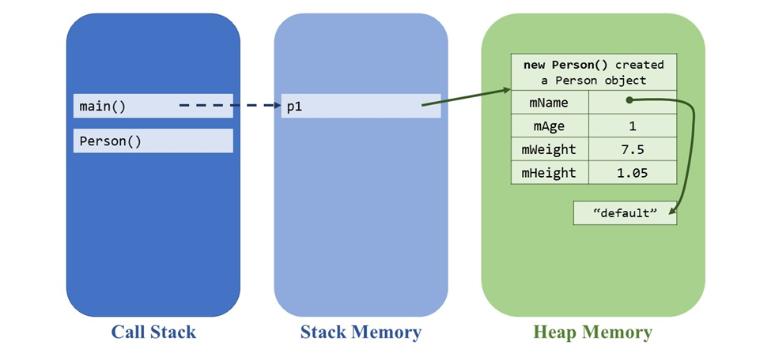
2.2 Constructors
Figure 2 2 Object created on heap memory

Slide 14
2.3 Providing accessor and mutator methods
Accessors or “Get” Methods
are instance methods that retrieve the values of the instance variables but do not modify the values of the instance variables
allows to safely expose value of the encapsulated variables outside of the class definition
Syntax: invoking an object’s instance method
objectName.instanceMethodName( . . . );

Slide 15
2.3 Providing accessor and mutator methods
Accessors and Safe Encapsulation
make sure that the accessor methods do not allow external users to directly modify the values of the instance variables by switching around the instance variables’ references or its reference values

Slide 16
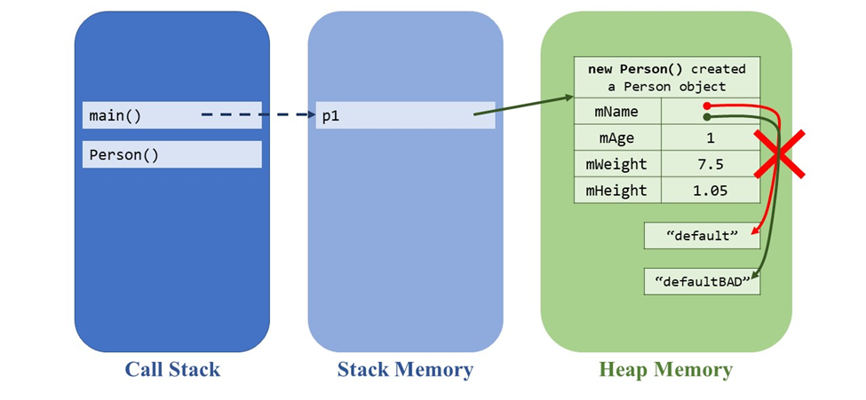
2.3 Providing accessor and mutator methods
Accessors and Safe Encapsulation
Figure 2 3a Directly modifying an instance variable reference—IMPOSSIBLE because mName is private

Slide 17
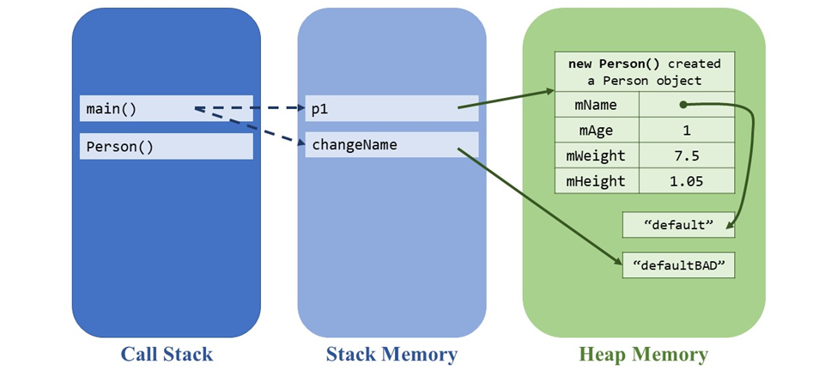
2.3 Providing accessor and mutator methods
Accessors and Safe Encapsulation
String changeName = p1.getName();
changeName = changeName + “BAD”;
String-type objects are immutable
Figure 2 3d Changing the String creates a new reference to a new String

Slide 18
2.3 Providing accessor and mutator methods
Core Concept: encapsulation
Do not let external users directly access instance variables. Keep these instance variables private.
Safely encapsulate an object’s state. Safe encapsulation: external users cannot DIRECTLY access instance variables.
Safe access of instance variables: Create public accessor methods… …but only for those instance variables that you want users to see.

Slide 19
2.3 Providing accessor and mutator methods
Mutators or “Set” Methods
are instance methods that allow users to modify the value of an instance variable
be mindful of preserving a “correct” state for objects

Slide 20
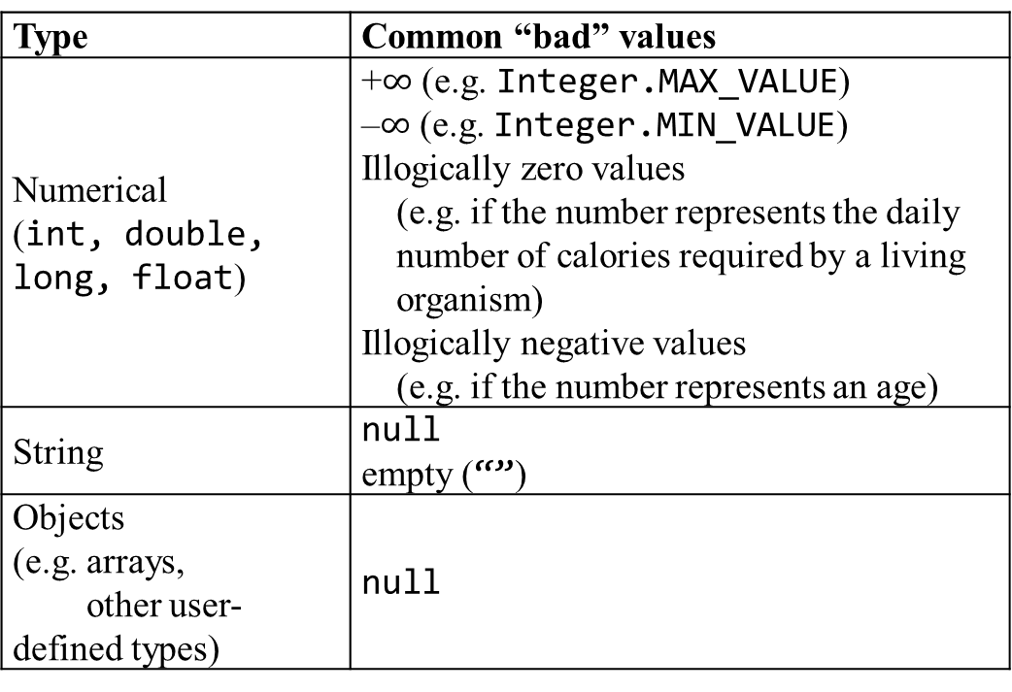
2.3 Providing accessor and mutator methods
Mutators and Safe Encapsulation
To make sure that users will not either maliciously or erroneously change an object’s instance variable to an illogical or “bad” value, perform checks in the mutator on the user’s input
Type | Common “bad” values
Numerical (int, double, long, float) | +$∞$ (e.g. Integer.MAX_VALUE) –$∞$ (e.g. Integer.MIN_VALUE) Illogically zero values (e.g. if the number represents the daily number of calories required by a living organism) Illogically negative values (e.g. if the number represents an age)
String | null empty (“”)
Objects (e.g. arrays, other user-defined types) | null

Slide 21
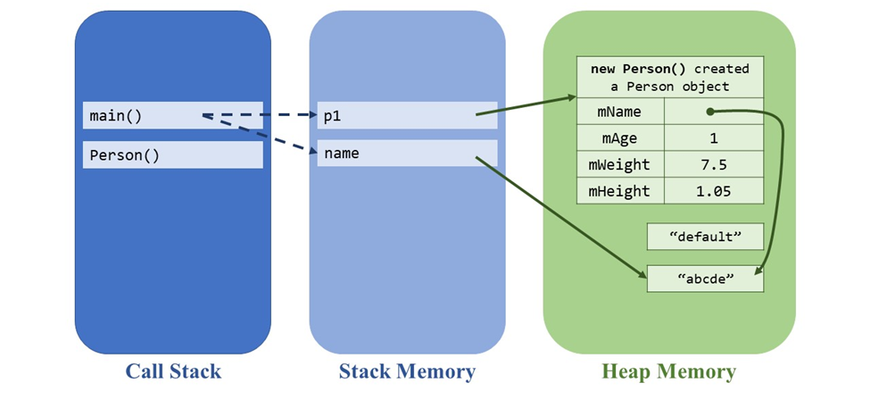
2.3 Providing accessor and mutator methods
p1.setName(name);
Java garbage collection will gather up the untethered “default” String object to free up computer memory.

Slide 22
2.3 Providing accessor and mutator methods
Core Concept: encapsulation
Do not let external users directly access instance variables. Keep these instance variables private.
Safely encapsulate an object’s state. Safe encapsulation: external users cannot DIRECTLY access instance variables.
Safe access of instance variables: Create public accessor methods… …but only for those instance variables that you want users to see.
Safe changes to instance variables: Create public mutator methods… …that check for “bad” input values first… …but only for those instance variables that you want users to update.

Slide 23
2.4 this—an Object Itself
“this” is a keyword used to refer to an object itself
Inside a class definition, all instance variables and instance methods can be accessed using this to specify that we want to refer to the object’s own members
Core Concept: this
Refer to members of an object itself. Accessing an object’s own instance variables: this.instanceVariableName Invoking an object’s own instance method: this.instanceMethodName()

Slide 24
2.4 this—an Object Itself
Clones, Aliases, and Originals
Cloning an object—making a “copy” of an original object that initially has identical state—creates another object in computer memory. The cloned object is a separate entity from the original object, and you can change its state without affecting the original object.
Aliases refer to the same object in the heap

Slide 25
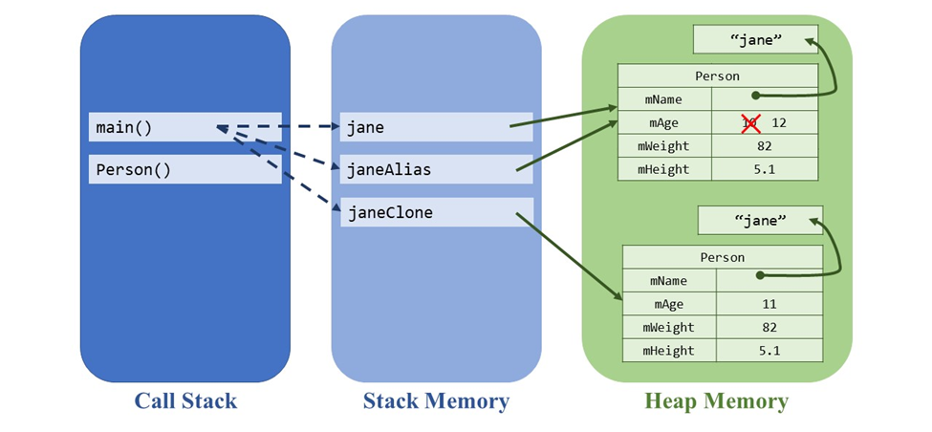
2.4 this—an Object Itself
Clones, Aliases, and Originals
The clone’s—and only the clone’s—age changes to 11
changing the alias’s age also changes the original’s age

Slide 26
2.4 this—an Object Itself
Clones, Aliases, and Originals
Core Concept: clones vs. aliases
 | Clones | Aliases
What are they? | copies of the original object | references to the original object
Where are they found? | new locations in the heap | same location as the original in the heap
What happens if you change their state? | only the clone’s state changes; the original state remains the same | the original’s state also changes

Slide 27
2.5 Tailored Instance Methods
Object is the ancestral class from which all other classes are descended
classes receive certain “defaults” from the Object superclass. One of these “defaults” is the toString() method, which is set in Java to return the heap memory address of the object.
if we want to change the behavior of an object’s toString() method, we must overrule the Object-defined default and write our own version. This is done with the special @Override annotation.

Slide 28
2.5 Tailored Instance Methods
Referential vs. Structural Equality
The double equals == operator: for referential equality. Referential equality asks whether two entities live in the same memory location, i.e. for objects, within heap memory.
the equals() method tests for structural equality. Structural equality asks whether two entities have the same values

Slide 29
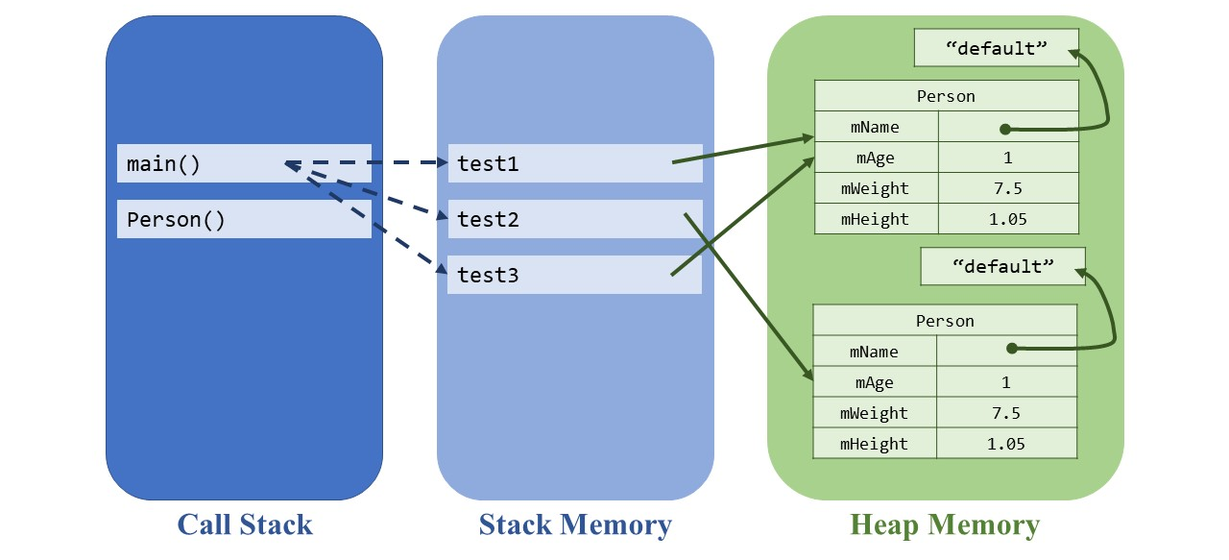
2.5 Tailored Instance Methods
Referential vs. Structural Equality
test1 and test2 are structurally equal
test1 and test3 are referentially equal

Slide 30
2.5 Tailored Instance Methods
.equals(Object o)
Object superclass implements .equals() by checking only for referential equality
the equals() method tests for structural equality. Structural equality asks whether two entities have the same values

Slide 31
2.5 Tailored Instance Methods
@Override
public boolean equals(Object o) {
if (o == null) {
return false;
}
if (o instanceof Person) {
Person other = (Person) o;
return (this.mName.equals(other.getName()) &&
this.mAge == other.getAge() &&
this.mWeight == other.getWeight() &&
this.m_height == other.getHeight());
}
return false;
}
.equals(Object o)

